Slide 1
Network Automation Using Python
Dhruti Sangal - 1913076
Krishna Pal - 1913097
Vrunda Patel - 1913101
Guide: Prof. Jyoti Varavadekar

Slide 2

PROBLEM STATEMENT
Most of the time, organizations ranging from business to education employ this technology. Computer networks are used in information technology to organize and integrate data. For networked devices, a manageable network configuration will be simpler to maintain and less likely to cause communication issues. In the past, network managers had to manually set up every network device. This procedure is ineffective and time-consuming. Although it is relatively slow, automated network configuration can get around the repetitive process

Slide 3
OBJECTIVES
Discard manual labour: By automating the network, repeatable, predictable network changes can take the place of manual labour.
Secure Remote Connection: SSH (Secure Shell) is a secure method for remote access as it includes authentication and encryption.
Accelerate change: Execute network changes that were previously infrequently done because they required physical labour, a lot of time, and a lot of resources.
Permitted access: Rather than all users having the credentials only the authentic user can access it.

Slide 4
INTRODUCTION

Slide 5
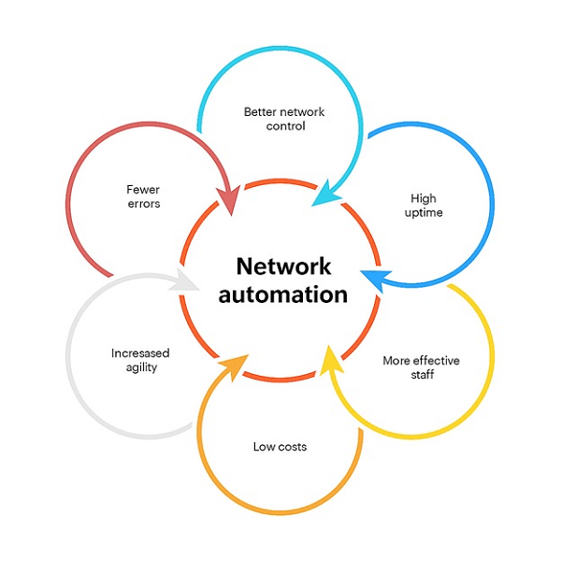
What is Network Automation? Network automation refers to the use of technology to automate and streamline the management and operation of computer networks.

Slide 6
The Benefits of Network Automation
Consistency
Scalability
Enhanced Security
Improved Efficiency
Increased Reliability
Faster Deployment Times

Slide 7
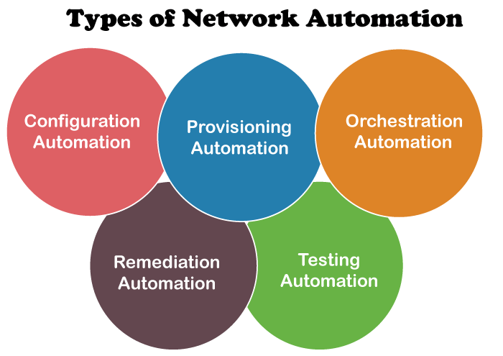

Slide 8
What is Configuration?
Routing is one of the most essential procedures in data communication. It ensures that data travels from one network to another with optimal speed and minimal delay and that its integrity is maintained in the process.
Broadly, routing is performed in two different ways:
Dynamic routing
Static routing

Slide 9
Various Routing Configurations
Static Routing:
Static routing is a form of routing that occurs when a router uses a manually-configured routing entry, rather than information from dynamic routing traffic.
Routing Information Protocol Routing:
(RIP) is a dynamic routing protocol that uses hop count as a routing metric to find the best path between the source and the destination network. It is a distance-vector routing protocol and works on the Network layer of the OSI model.
OSPF Routing
Open Shortest Path First (OSPF) is a link-state routing protocol that was developed for IP networks and is based on the Shortest Path First (SPF) algorithm. OSPF is an Interior Gateway Protocol (IGP).

Slide 11
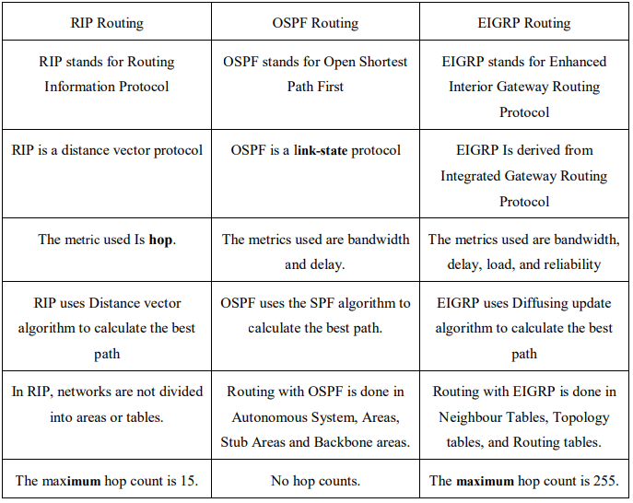

Slide 12
Literature Survey

Slide 14
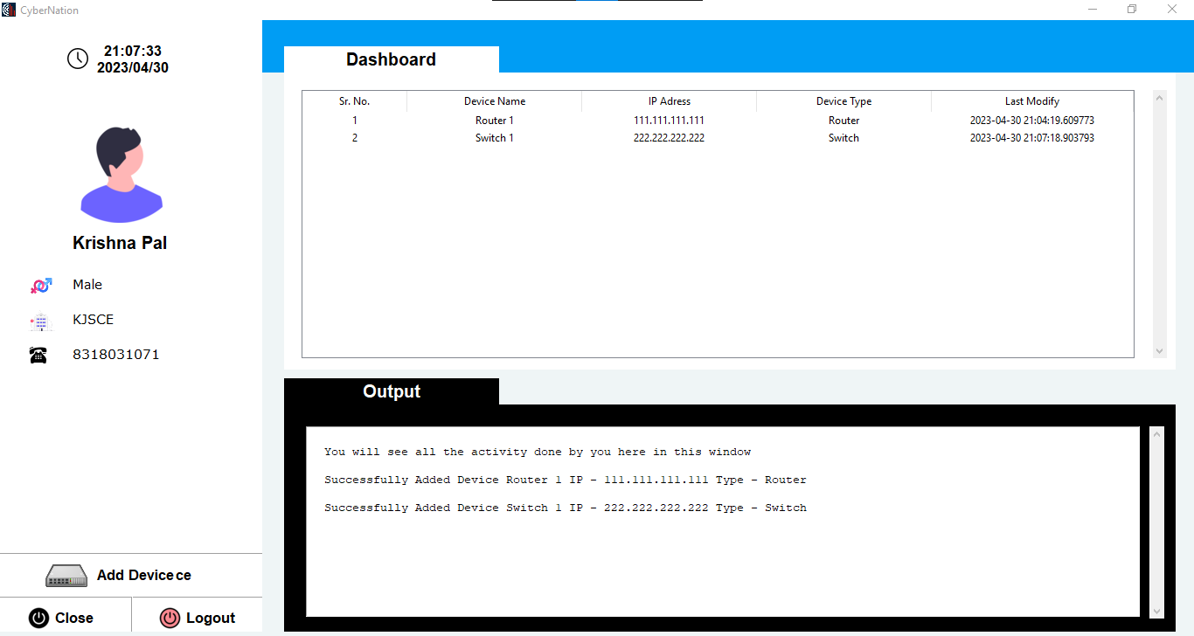
Cybernation

Slide 15
Softwares To Be Used
GNS3
VSCode
SQLite Database

Slide 16

Technologies To Be Used
Automation is the step that your network is looking for, to make your life easier as a Network Engineer. Python will help you eliminate unnecessary steps for your Network. Python allows you to build scripts to automate complex network configuration. It is the most widely used programming language for software-defined networking
Python Libraries that we are using are as:
Netmiko
Telnet
IPAddress
Tkinter
SQLite
Threading

Slide 17
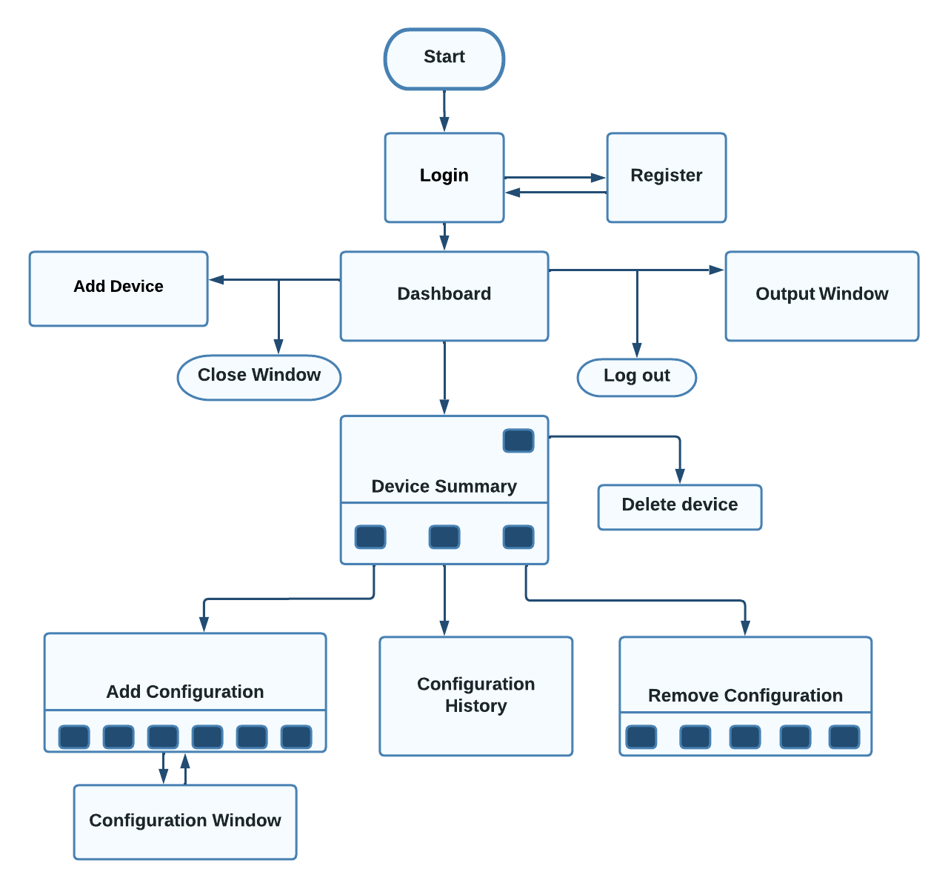
Project Flow

Slide 18
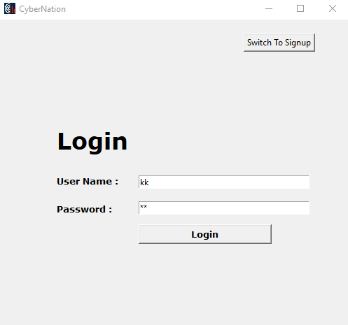
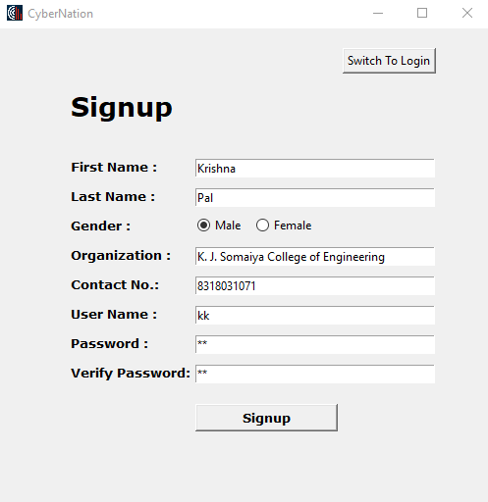

Slide 19
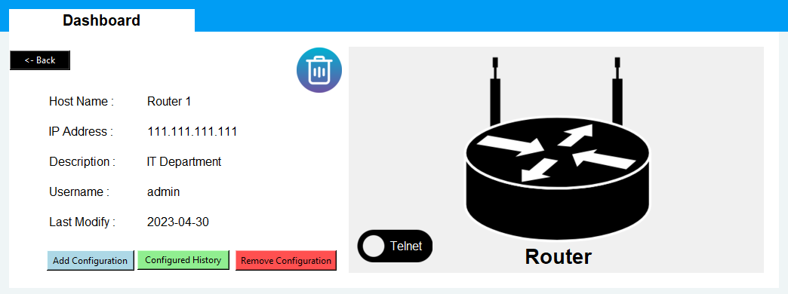
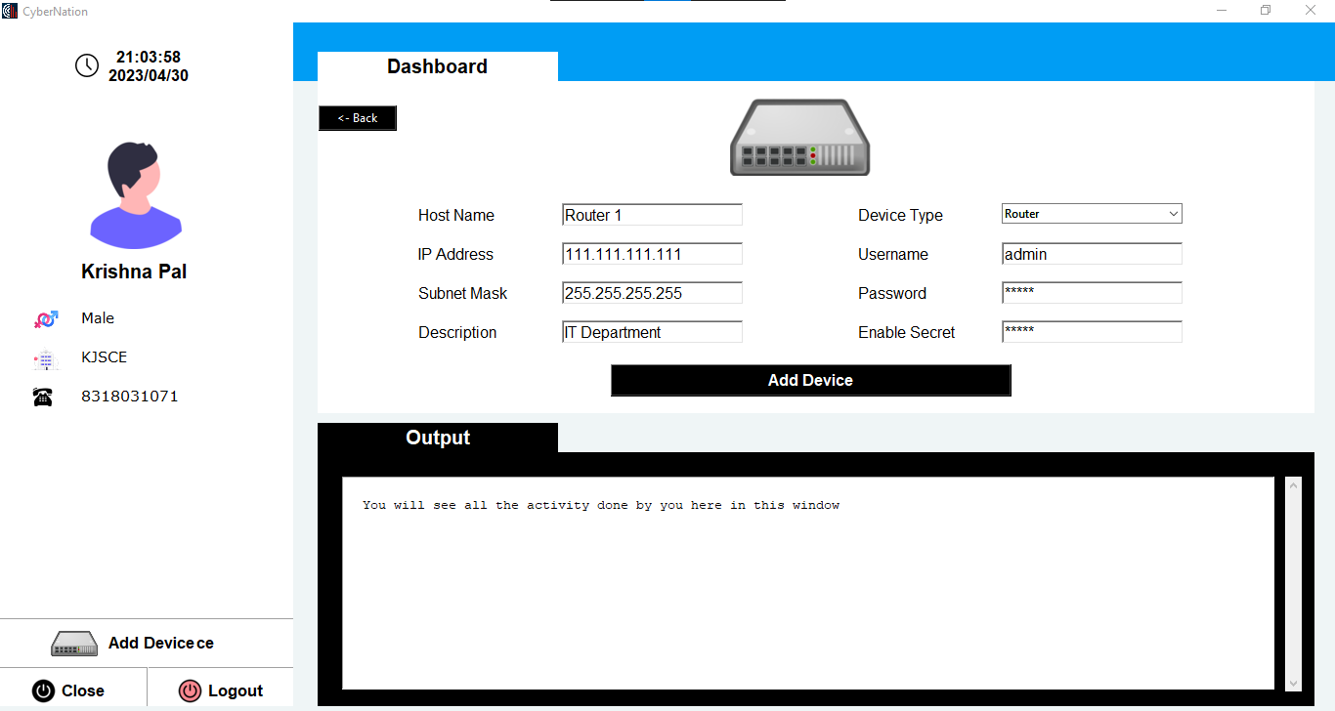

Slide 20
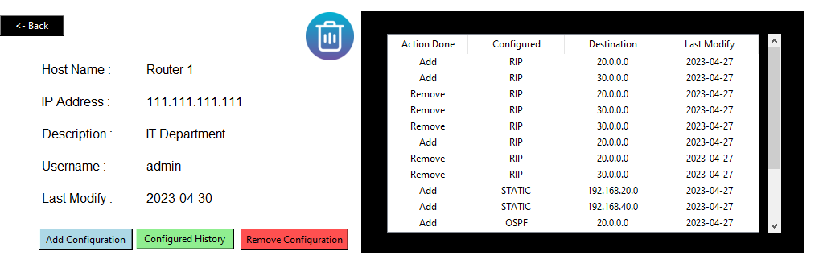
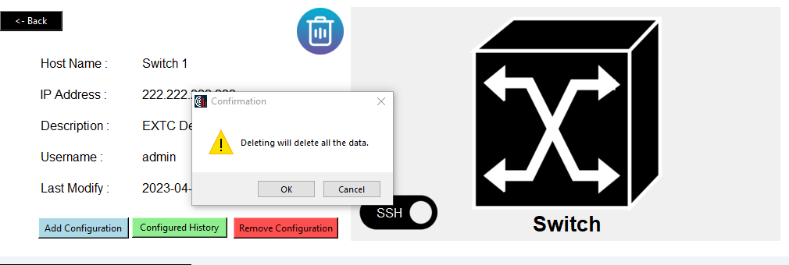

Slide 21
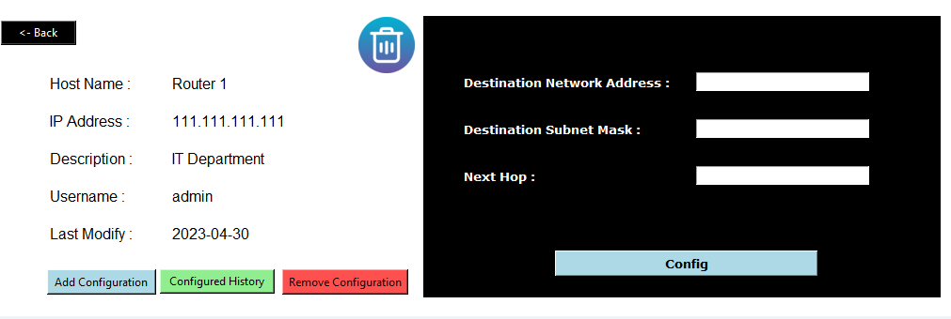
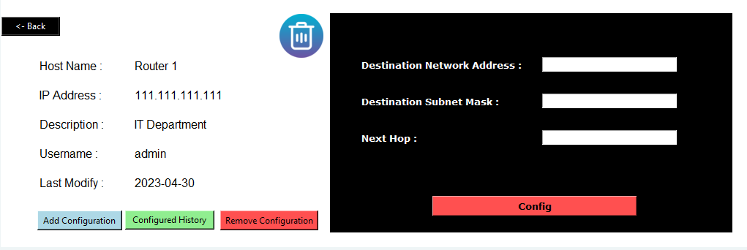

Slide 22
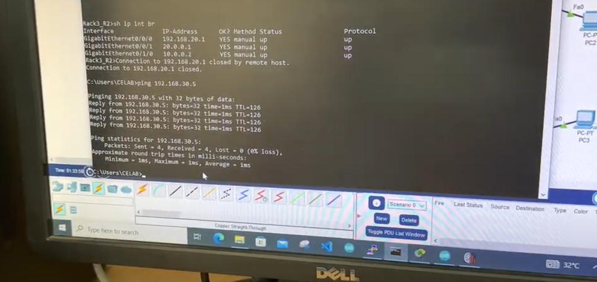

Slide 23
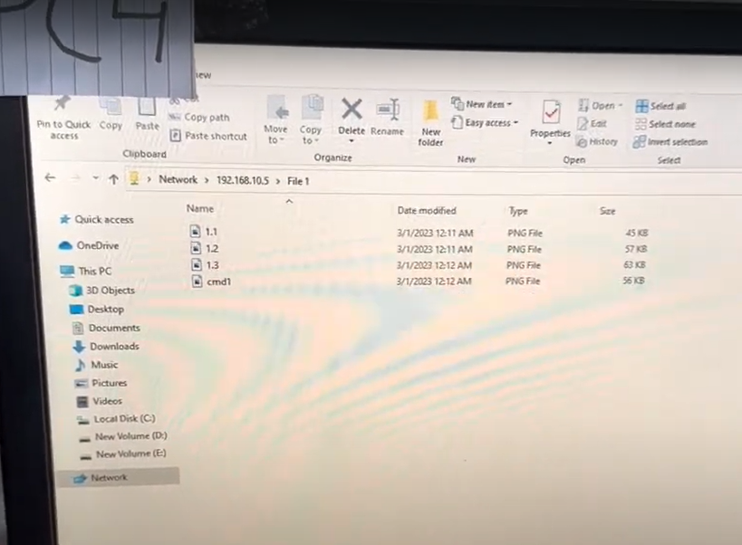

Slide 24
THANK YOU!

